Slide 1

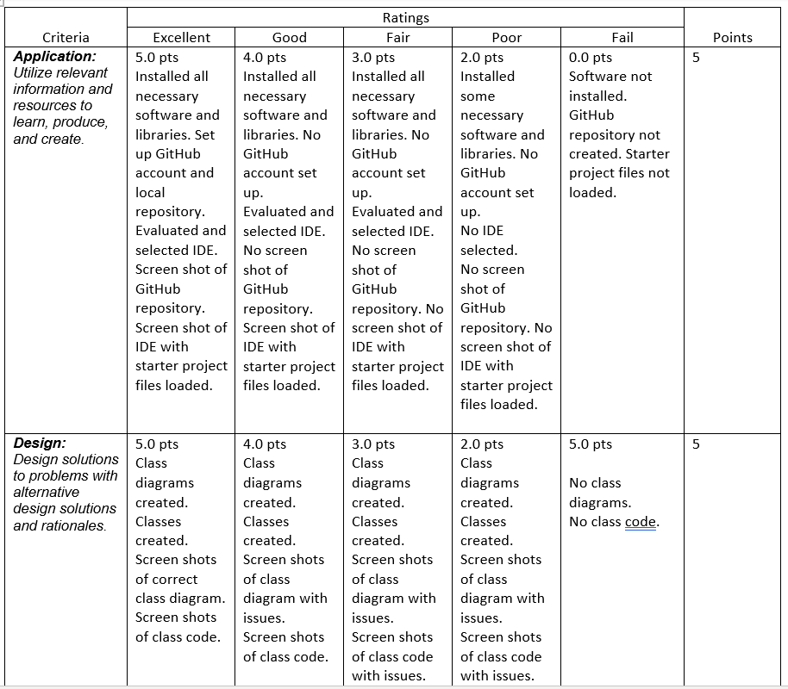
Final Project Deliverables
Rubric
Slides
Title
Introduction
Slides for Each Project Module
Description of Module
Results (Screen Shots)
Challenges
Career Skills Developed
Conclusion
Professional Quality
Final Program Pushed to GitHub
Project Posted on Portfolio site with Link

Slide 2
CEIS150 FinaL PRoJECT
By: NOAH KELLEY

Slide 3
InTRODUCTION
This class was all about Python and showing us what we can create with coding. In this project, we were giving different sets of codes and we had to fix the errors so the program can run.

Slide 4
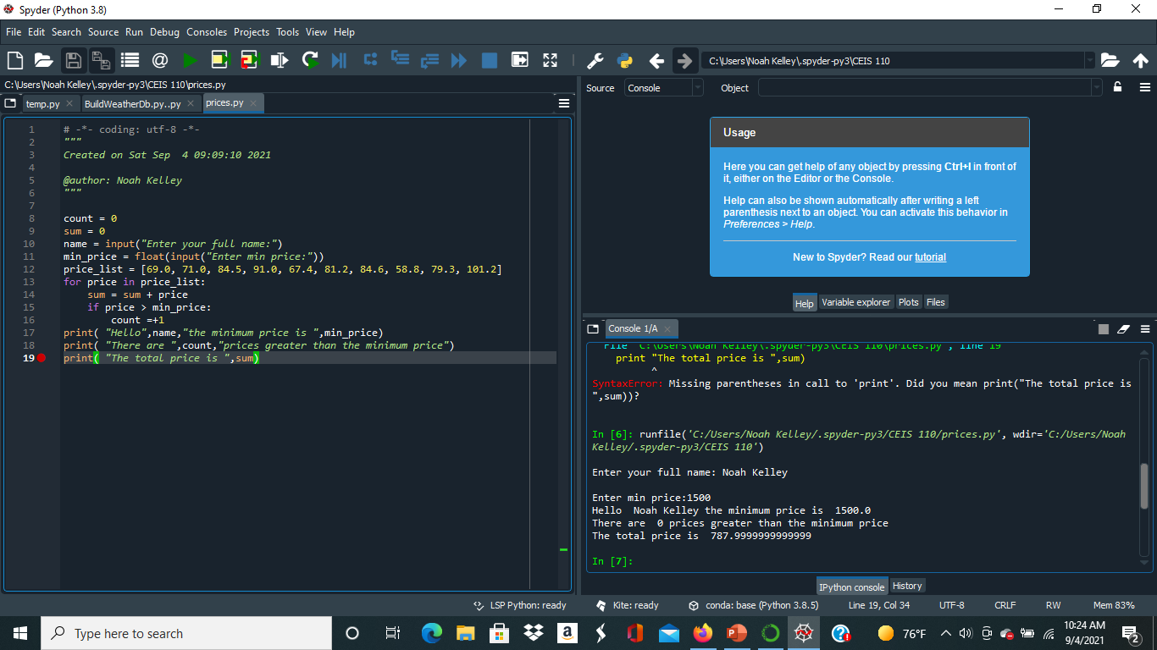
Program
Screen shot of Python program running successfully.

Slide 5
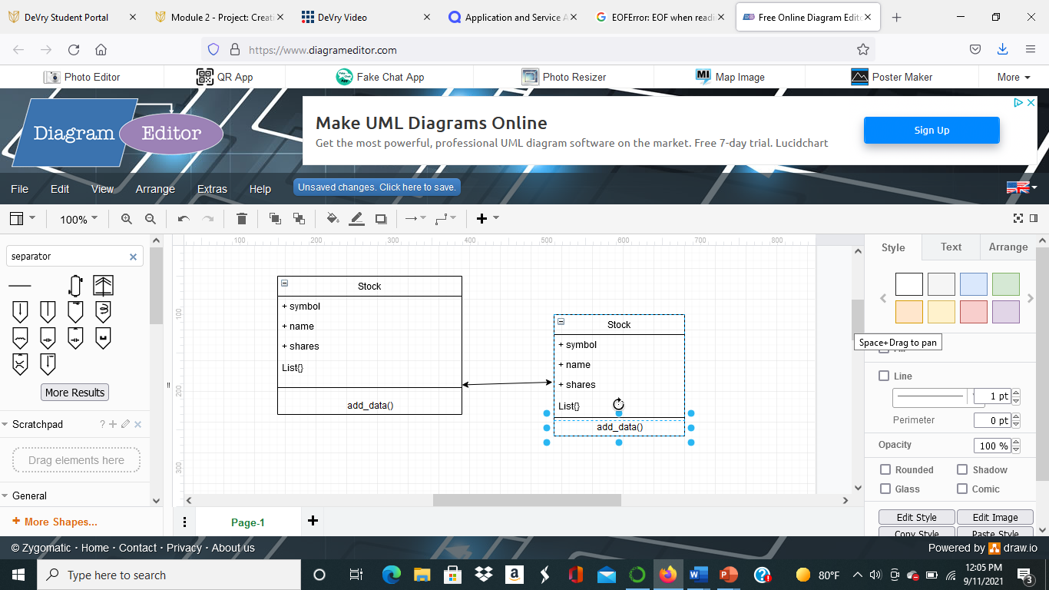
Class Diagram
Paste your Visio Class Diagram

Slide 6
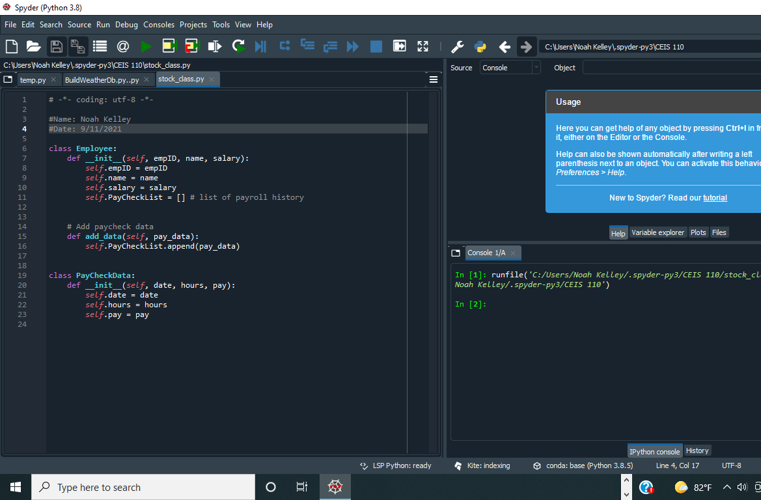
Class Code
Screen Shot of your stock_class.py file.

Slide 7
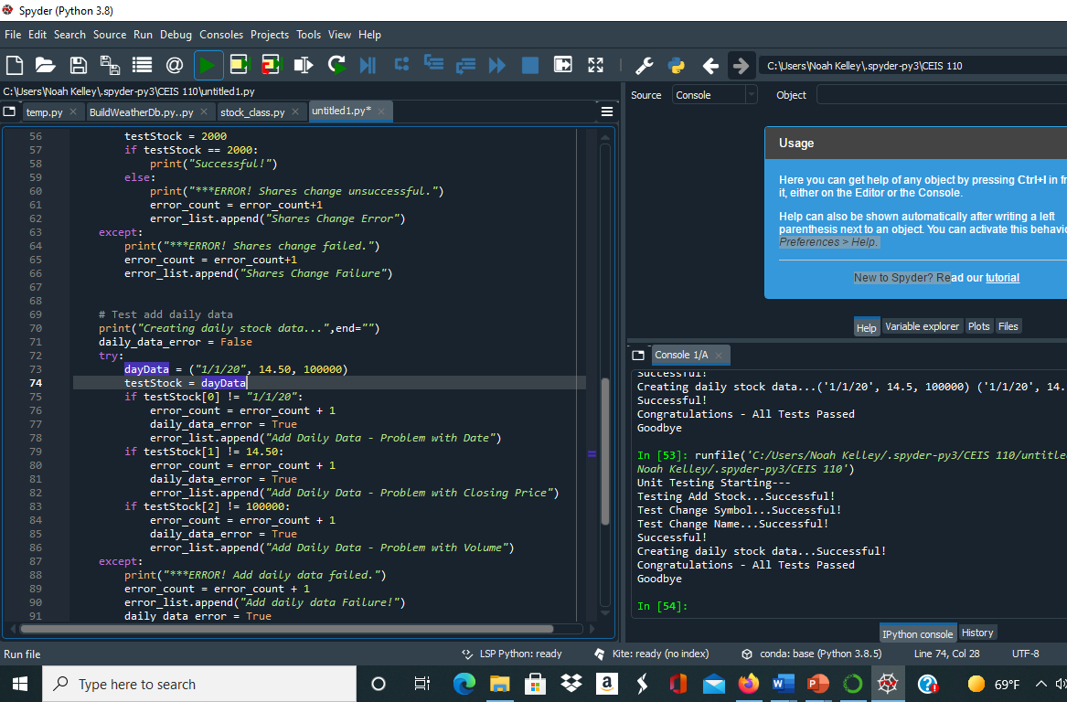
Unit Test
Screen Shot of your successful unit test.

Slide 8
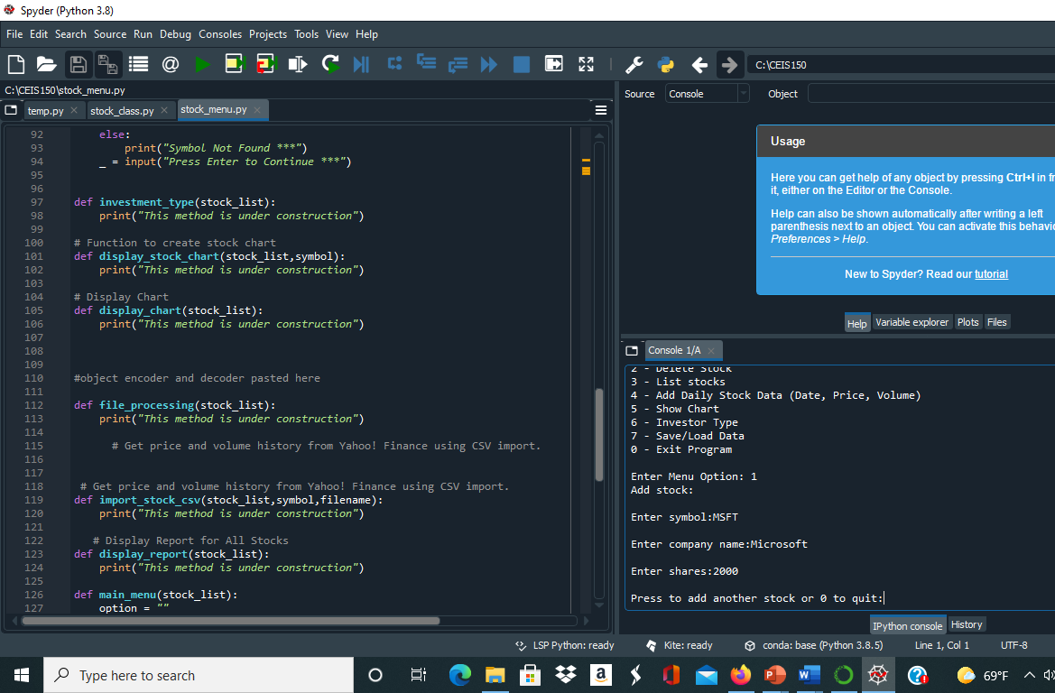
Adding a Stock
Paste a screen shot of your working Stock program.

Slide 9

Listing 3 Stocks
Paste a screen shot of your working Stock program.

Slide 10

Daily Data
Paste a screen shot of your working Stock program.

Slide 11
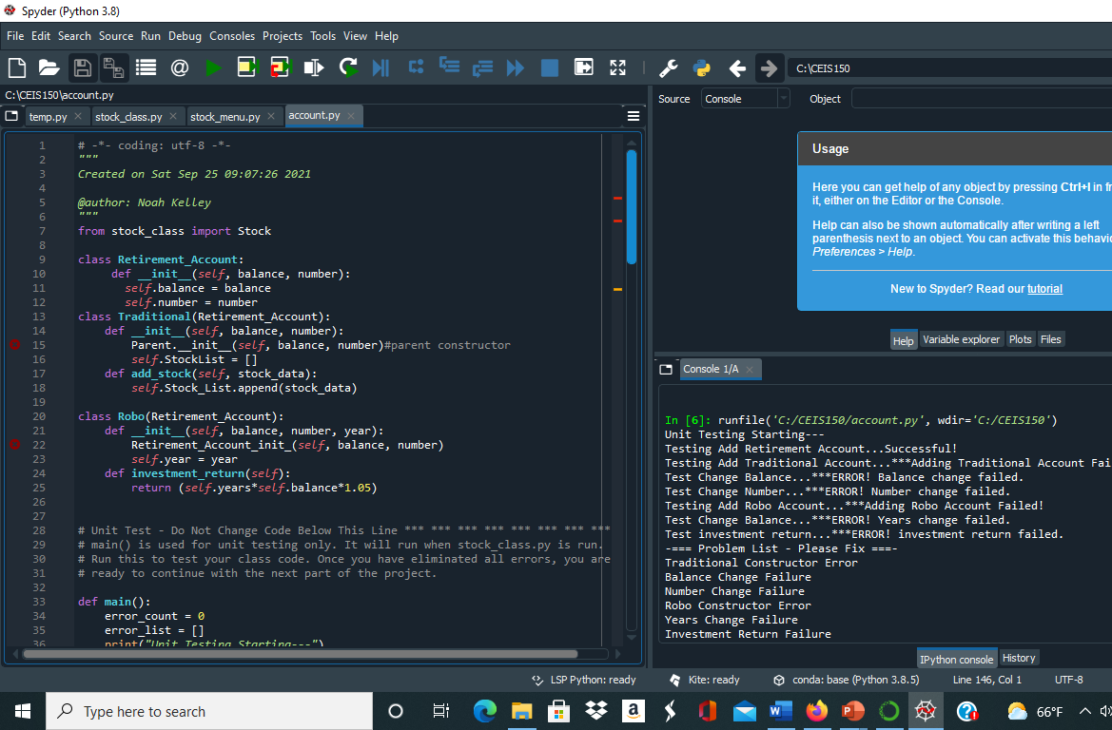
Inherited classes
Paste a screen shot of your classes

Slide 12
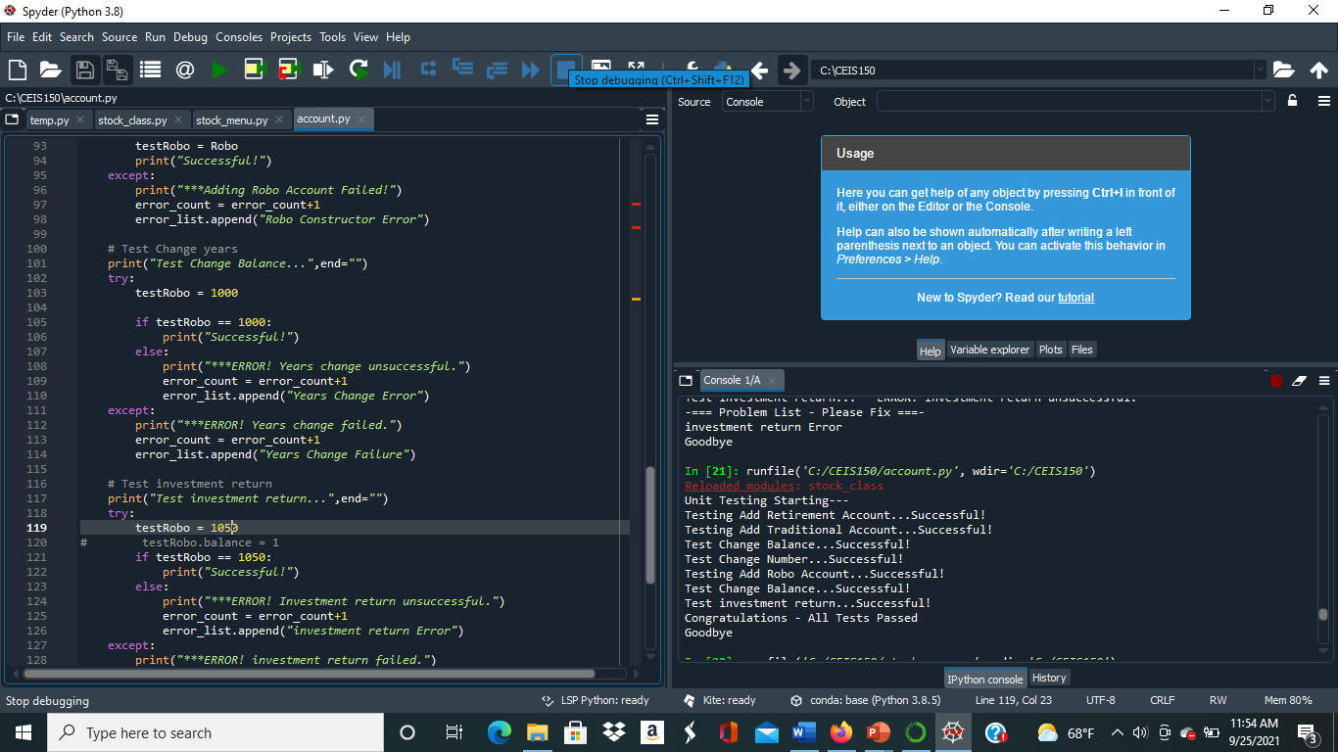
Unit Tests
Paste a screen shot of your unit tests successfully completed

Slide 13
Stock menu program
Paste a screen shot of your classes in the main program

Slide 14
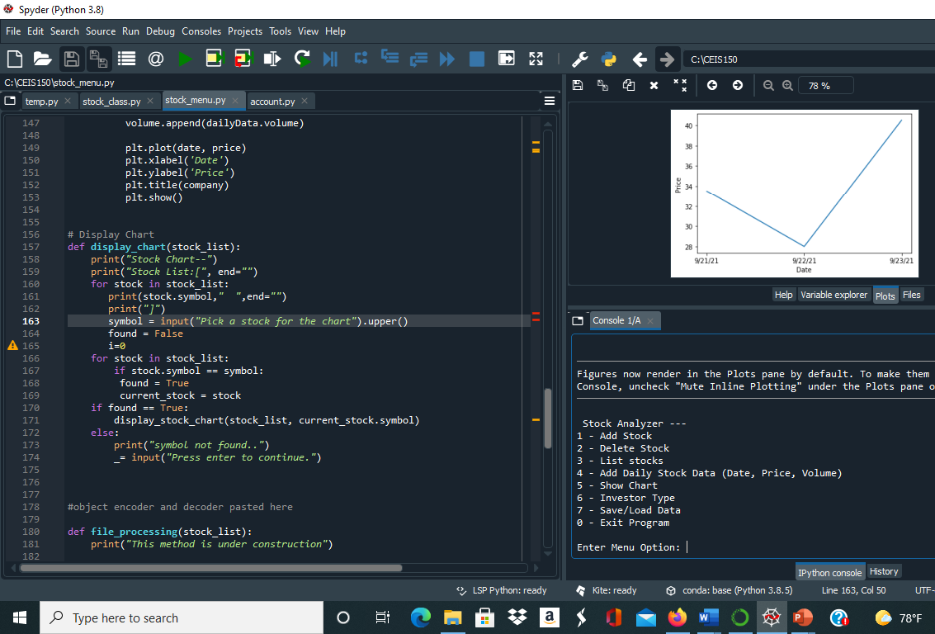
Chart
Paste a screen shot of your stock chart.

Slide 15
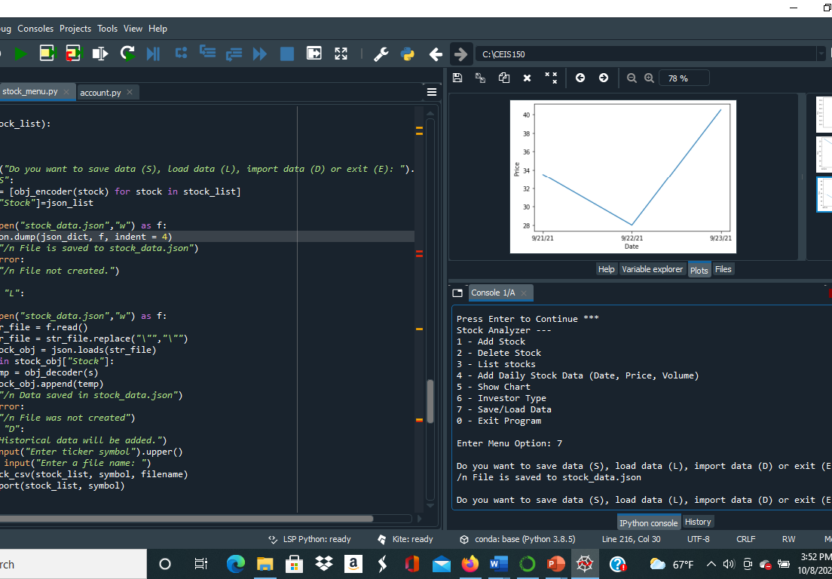
Saving Data
Paste a screen shot of the data saved to a file

Slide 16
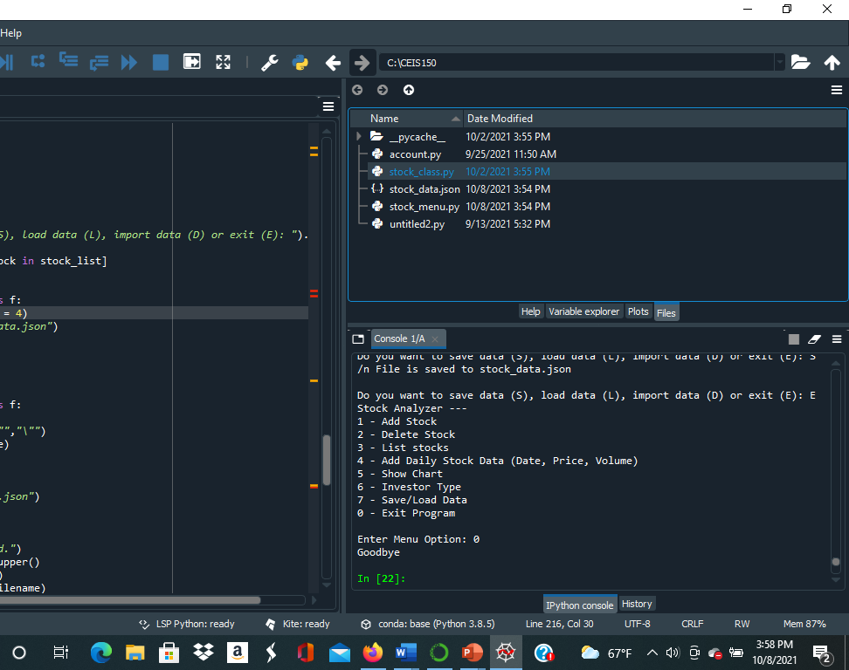
File
Paste a screen shot of the file created in file explorer

Slide 17
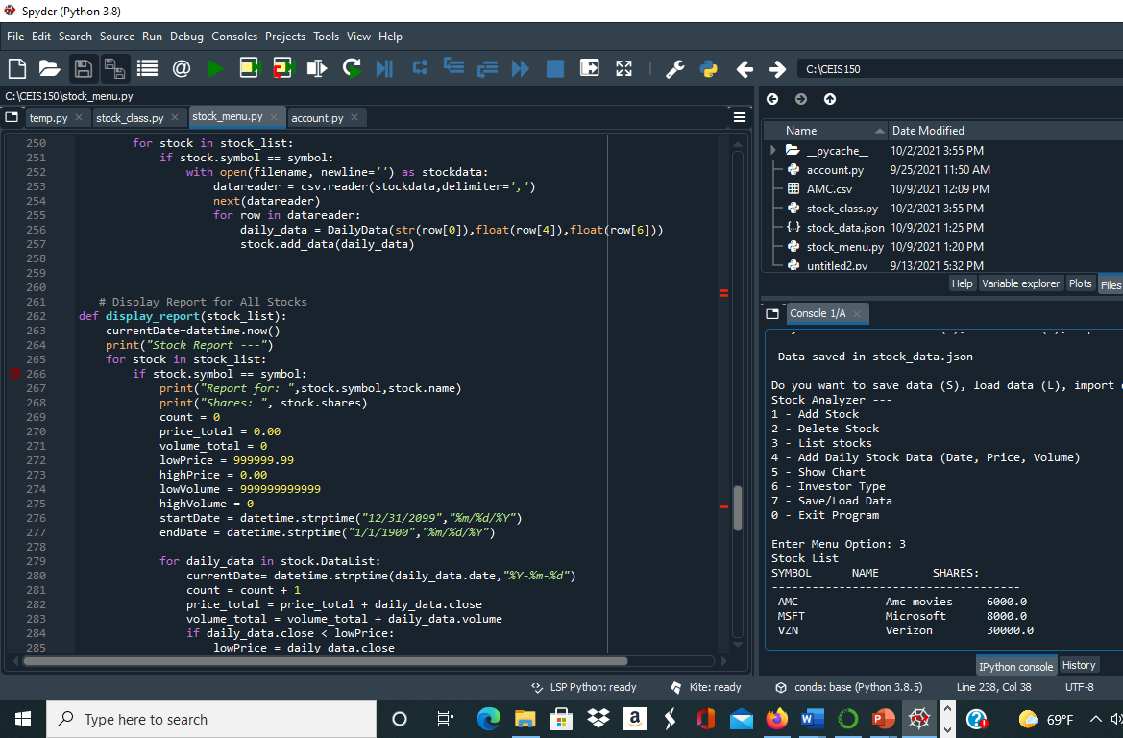
Loading Data
Paste a screen shot of stock listing

Slide 18
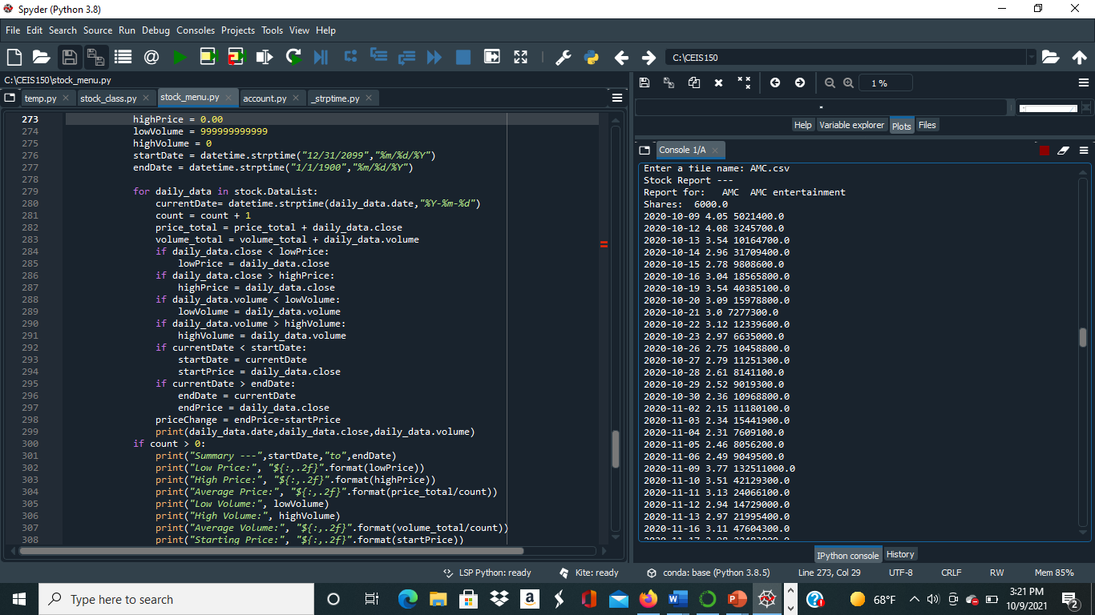
Importing data
Screenshot of the historical data import

Slide 19

CHallenges
The hardest part about doing this project was making sure the class of the program matched the main part of the program because the code wouldn’t run the way I wanted it.

Slide 20
Career Skills Obtained
Problem solving
Creativity
Responsibility

Slide 21
Conclusion
Doing this project has helped me learn more about what you can do with code and how complex python can be. I never new how much coding is involved when it comes to stock and running a business, but it is important. I can use what I learned this session to help me in the future when I get my first job.

